Slide 1
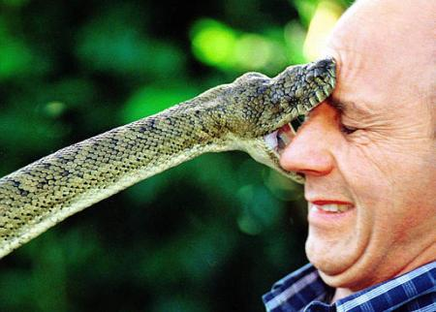
Reptiles of Ohio
Notes:
- 46 species and subspecies in Ohio (11 turtles, 30 snakes, and 5 lizards)

Slide 2
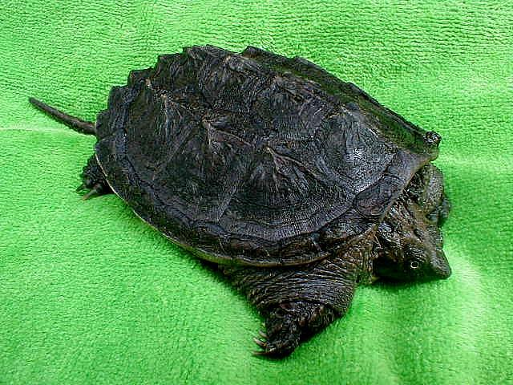
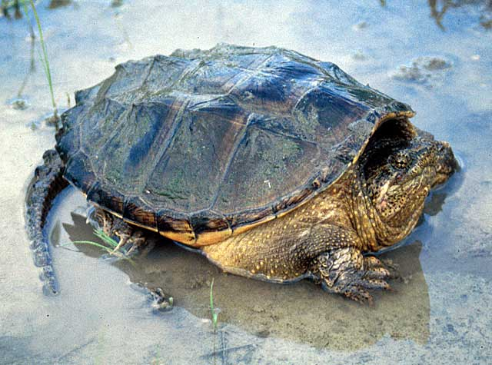
Common Snapping Turtle
Chelydra serpentina
Notes:
Family – Chelydridae
Chelydra serpentina
Snapping Turtle
- Carapace: looks like mountains, very ridgey, posterior end ends in points
- Plastron: small, barely covers flesh
- Long tail, saw-toothed on top
- Large turtle, 8-14” w/ record of 19”
- Live in any permanent pond they can find
- Used to make turtle soup
- Very defensive w/ a strong bite

Slide 3
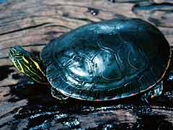
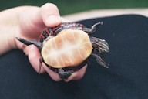
Midland Painted Turtle
Chrysemys picta
Notes:
Family – Emydidae
Chrysemys picta
Painted Turtle
- Carapace: Greenish, edges have a red “painted” pattern to it
- Plastron: Whole, yucky yellow
- Moderate sized turtle, 5-6”
- Found in any permanent pond
- Commonly seen basking around lakes and rivers
- Very common in Ohio

Slide 4
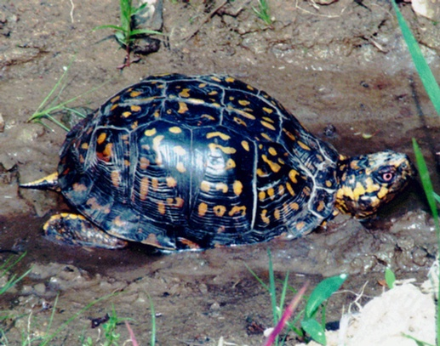
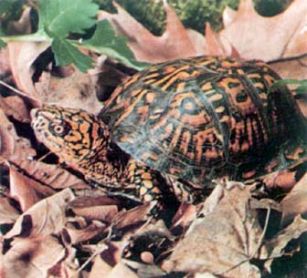
Eastern Box Turtle
Terrapene carolina
Notes:
Family – Emydidae
Terrapene carolina
Eastern Box Turtle
- Carapace: Domed, black w/ intricate patterning
- Plastron: Dark brown w/ little yellowish blemishes, hinged in the front so it closes completely
- 4 toes on hind feet
- Moderate sized turtle, 5-6”
- Highly terrestrial
- Omnivorous
- Female has yellow eyes, male has red eyes and a concave plastron

Slide 5
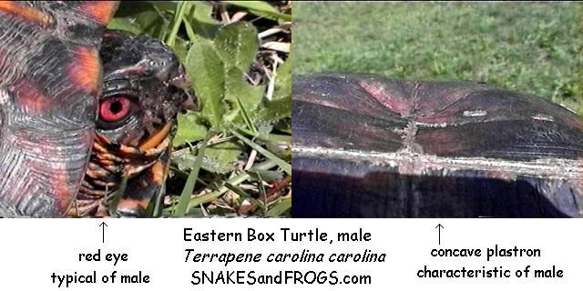
Features of the Male Box Turtle

Slide 6
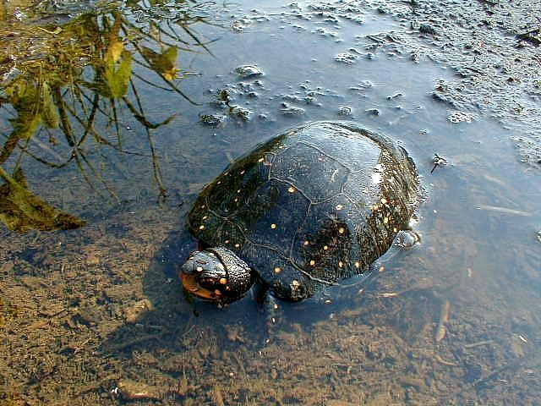
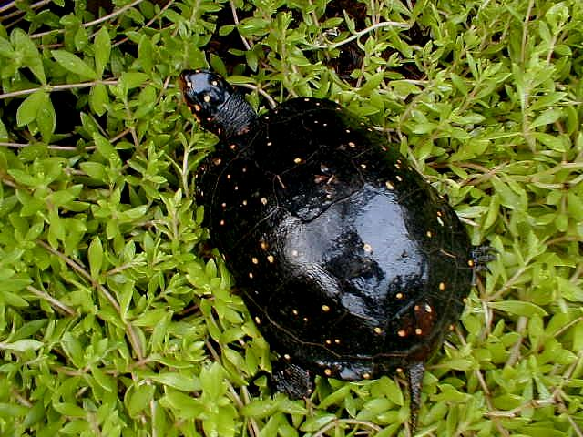
Spotted Turtle
Clemmys guttata
Notes:
Family – Emydidae
Clemmys guttata
Spotted Turtle
- Carapace: Black w/ yellowish spotted dots (looks like spotted salamander)
- Plastron: Whole and yucky yellow w/ a patch of black on each plate
- Moderate sized, around 4-5”
- Restricted to Bogs, swamps, and other wet areas
- Spend summers in aestivation (hibernation like state), so it is usually found in early spring and mid to late fall
- Uncommon in Ohio

Slide 7
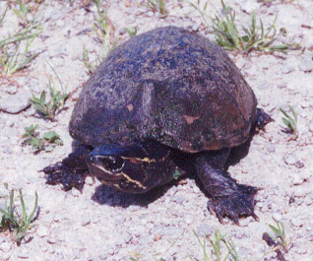
Common Musk Turtle
Sternotherus odoratus
Notes:
Family – Kinosternidae
Sternotherus odoratus
Common Musk Turtle
- Carapace: Light brown on sides & becomes darker as you go up & in middle
- Plastron: Yellowish & pinkish by ridge
- 2 light stripes on head
- Barbels on chin and throat
- Smaller turtle, 3-4”
- Aquatic
- Domed shell
- Has musk gland that secretes sulfur based compound as defense
- Sometimes called a stink pot turtle

Slide 8
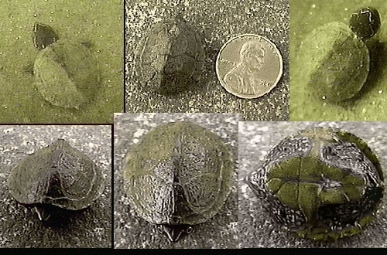
Common Musk Turtle Hatchling

Slide 9
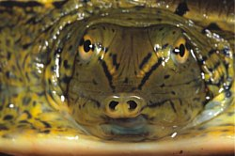
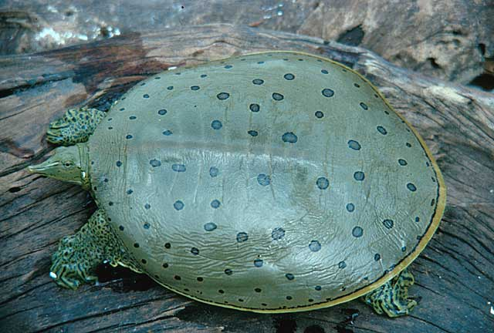
Spiny Softshell Turtle
Apalone spinifera
Notes:
Family – Trionychidae
Apalone spinifera
Softshell Turtle
(In prep room, slide availiable)
- Plastron: Leathery, no scutes (scales), pale brown with small dark spots
- Pointed, snorkel like nose
- Spiny projections on front of carapace
- Typically 7-9”, but females can get up to 18”
- Aquatic
- Uses nose like a snorkel in shallow water
- Does not have to get air from the surface, While submerged, it pumps water in and out of its mouth and pharynx. The highly vascular lining of the pharynx removes oxygen from the water and expels carbon dioxide into it.

Slide 10
Other Ohio Turtles
Not in our collection
Common Map Turtle – Graptemys geographica
Red-eared Slider - Trachemys scripta
Smooth Softshell - Apalone mutica
Wood Turtle - Clemmys insculpta
Notes:
Map Turtle – Southern Ohio, found in the Scioto & Ohio Rivers
Red-ear Slider – Introduced from captivity, isolated populations
Smooth Softshell – Southern Ohio, large rivers/streams
Wood Turtle – North-east corner of Ohio, at edge of range, very rare
* All of these are uncommon in Ohio

Slide 11
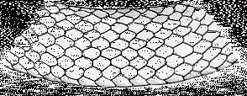
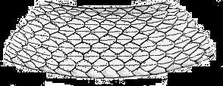
Smooth Scales have a smooth surface that reflects the light. If you are not sure it has smooth scales, but your snake has a shiny, glossy or irridescent color pattern, chances are it has smooth scales.
Keeled Scales usually have a dull, no-gloss surface. If you are not sure it has keeled scales, but your snake is not shiny and its color pattern is dusty, drab or dull, chances are it has keeled scales.
http://www.flmnh.ufl.edu/herpetology/FL-GUIDE/smovskldscales.htm

Slide 12
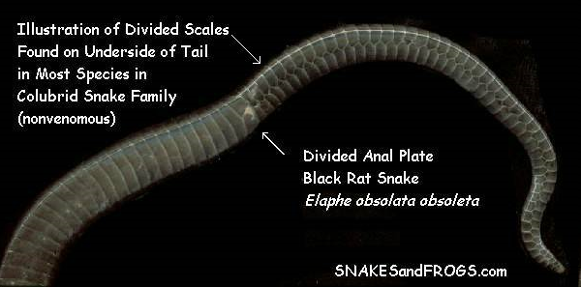
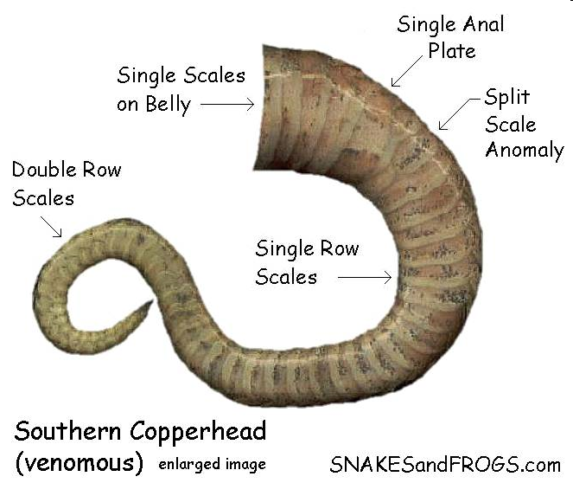
Anal plate = scale just before cloaca

Slide 13
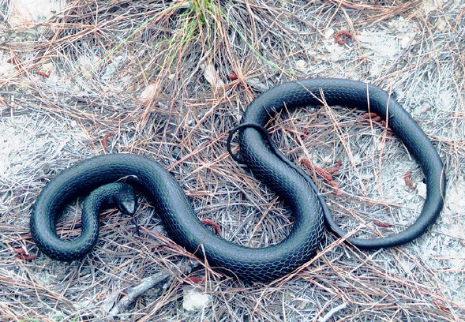
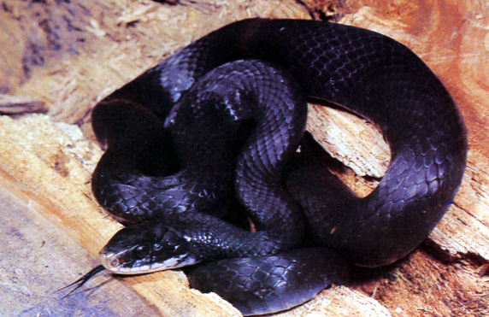
Black Racer
Coluber constrictor
Notes:
Family – Colubridae
Coluber constrictor
Black Racer
- Completely black
- White under chin, rest of the underneath is gray
- Smooth scales
- Anal plate divided
- 4-6’ long
- Common in Ohio
- Young are gray w/ dark blotches, slowly turn solid black
- Has a temper, will bite, but won’t cause much damage
- Called a “racer” because they move very fast (8mph)
- Defecate & use musk glands as defense mechanisms
- Feed on rodents, amphibians, and birds

Slide 14
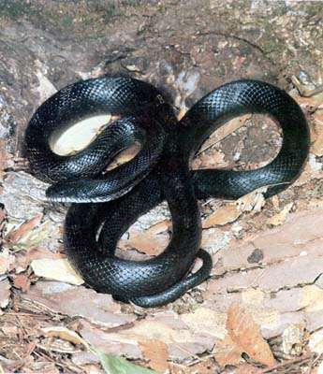
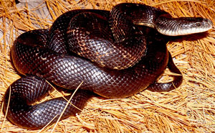
Black Rat Snake
Pantherophis obsoletus
Notes:
Family – Colubridae
Scotophis obsoletus (name recently changed from Elaphe genus)
Black Rat Snake
- Black w/ traces of old juvenile pattern
- Bottom is whitish w/ black blotches
- Scales are weakly keeled
- Anal plate divided
- Typically 4-6’, with a record of over 8’
- Patterned when young, then get darker as they get older
- Fairly common in Ohio
- Largest snake in Ohio (record is 101”)
- Can rattle their tail in leaf litter, often confused w/ rattlesnake
- Highly arboreal
Feed on rodents, birds, and occasionally bird eggs
a constricting species, unlike, oddly enough, Coluber constrictor

Slide 15
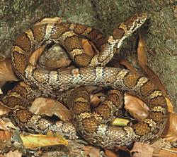
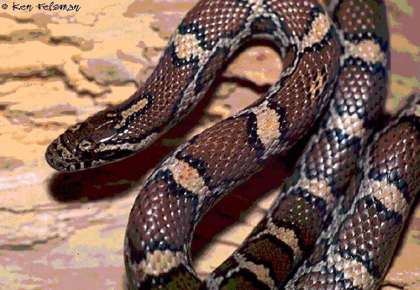
Eastern Milk Snake
Lampropeltis triangulum
Notes:
Family – Colubridae
Lampropeltis triangulum
Eastern Milk Snake
- Reddish/brownish saddle marks on a lighter background
- Checkered pattern (black & white) on belly
- Anal plate is single
- Scales are smooth
- 2-3’, rarely up to 4’
- Commonly found in barns
- Found in a range of habitats
- Eat rodents
- Once believed to eat milk straight from the cow, believed to be able to suck them dry

Slide 16
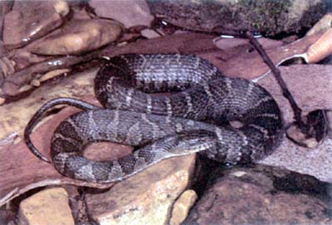
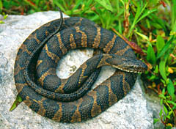
Northern Water Snake
Nerodia sipedon
Notes:
Family – Natricidae
Nerodia sipedon
Water Snake
- Dark bands on a lighter background
- Strongly keeled scales
- Anal plate is divided
- Typically 3-4’
- Often confused with cottonmouth (water moccasin), however cottonmouth is not found in Ohio
- Very common thru-out Ohio, around permanent bodies of water
- Very bad temper, will bite and musk when captured
- The only large, heavily bodied water snake in Ohio

Slide 17
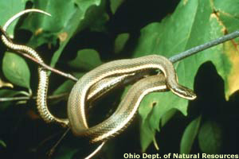
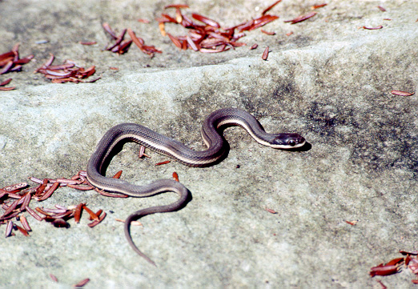
Queen Snake
Regina septemvittata
Notes:
Family – Natricidae
Regina septemvittata
Queen Snake
- Brown w/ light lateral stripe on the 1st & 2nd rows of scales
- Belly is yellow w/ brown stripes
- Scales are keeled
- Anal plate is divided
- Slender bodied snake
- Usually under 2’ long
- Found near water, especially around rocky bottomed streams
- Feed almost exclusively on crayfish

Slide 18
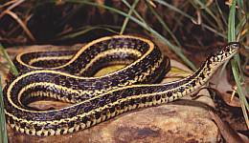
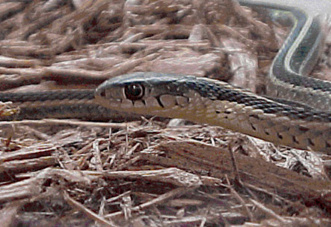
Eastern Garter Snake
Thamnophis sirtalis
Notes:
Family – Natricidae
Thamnophis sirtalis
Eastern Garter Snake
- Dark w/ lighter dorsal stripe and lateral stripe on the 2nd and 3rd rows of scales
- Scales are keeled
- Anal plate is single
- Usually around 2’ or less, record of 4’
- Tail less than 1/4 of total length
- Very common in Ohio
- Found in a wide range of habitats
- Melanistic specimens found around Lake Erie

Slide 19
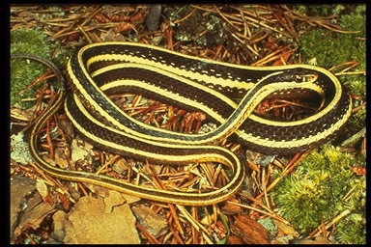
Eastern Ribbon Snake
Thamnophis sauritus
Notes:
Family – Natricidae
Thamnophis sauritus
Eastern Ribbon Snake
- Similar to Eastern Garter Snake
- Dark w/ lighter dorsal stripe and lateral stripe on the 3rd and 4th rows of scales (garter on 2nd and 3rd)
- Scales are keeled
- Anal plate is single
- Usually around 2’ or less
- Tail is 1/4 or more of total length
- More aquatic than Garter snake

Slide 20
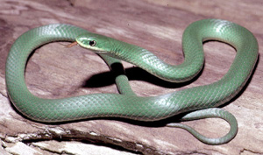
Smooth Green Snake
Liochlorophis vernalis
Notes:
Family – Colubridae
Liochlorophis vernalis
Smooth Green Snake
- Small, solid, bright green snake
- Scales are smooth
- Anal plate is divided
- Small snake, 10-20”
- Terrestrial
- Commonly found in bogs and fens
- Limited to north-eastern corner of Ohio

Slide 21
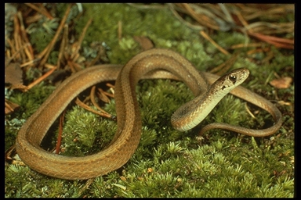
Midland Brown Snake
Storeria dekayi
Notes:
Family – Natricidae
Storeria dekayi
Midland Brown Snake
- Grayish brown w/ black spots forming lines down the body from neck to tail
- Anal plate is divided
- Scales are keeled
- Very small, 10-15”
- Fairly common in Ohio
- Feeds on slugs, snails, and earthworms
- Very docile, doesn’t bite, but does musk
- Very sensitive to pollution

Slide 22
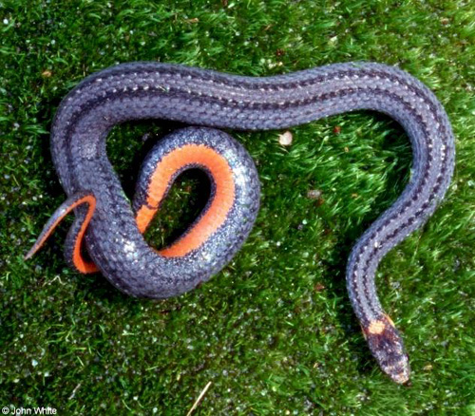
Northern Redbelly Snake
Storeria occipitomaculata
Notes:
Family – Natricidae
Storeria occipitomaculata
Redbelly Snake
- Grayish w/ black spots forming lines down the body
- Anal plate is divided
- Scales are keeled
- 3 light spots on neck
- Has a red belly (white in jar)
- Small snake, 8-12”
- Look and behave similarly to Brown Snake
- Found in moist woodlands and bogs

Slide 23
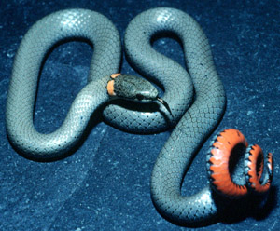
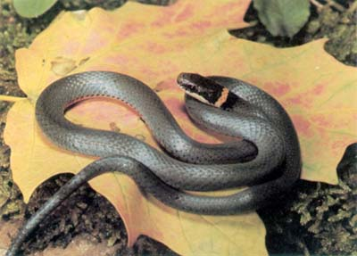
Northern Ringneck Snake
Diadophis punctatus
Notes:
Family – Dipsadidae
Diadophis punctatus
Northern Ringneck Snake
- Blackish-gray w/ ring around neck (usually red or yellow)
- Underside typically solid yellow
- Smooth scales
- Anal plate is divided
- Small snake, 10-20”
- Common in Ohio, but more in the south
- Found in woodlands w/ an abundance of rotting wood and rocks to hide under
- Feed heavily on salamanders

Slide 24
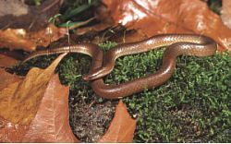
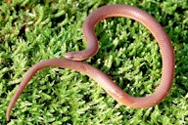
Worm Snake
Carphophis amoenus
Notes:
Family – Dipsadidae
Carphophis amoenus
Worm Snake
- Looks like a worm
- Plain brown above, belly pink
- Scales smooth
- Anal plate is divided
- Very small, 8-12”
- Fairly common in southern Ohio, however almost never in the open
- Smallest snake in Ohio
- Highly fossoral (lives underground)

Slide 25
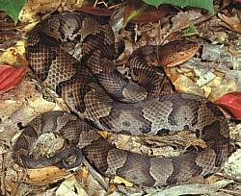
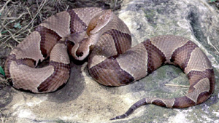
Northern Copperhead
Agkistrodon contrtrix
Notes:
Family - Crotalidae
Agkistrodon contortrix
Northern Copperhead
- Body-light brown w/ dark brown bands
- Bright red/orange head
- Deep facial pits present midway between eyes and nostrils
- Usually 2-4’
- Facial pits are heat sensitive
- Reasonably common in southern Ohio
- Somewhat docile
- Poisonous (not usually deadly to humans)

Slide 26
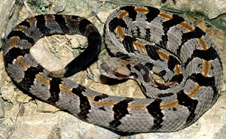
Timber Rattlesnake
Crotalus horridus
Notes:
Family - Crotalidae
Crotalus horridus
Timber Rattlesnake
- Pattern of transverse zig-zag, or chevron-shaped bands
- Keeled scales
- Anal plate single
- Tail terminating in a rattle
- Deep facial pits present about midway between eyes and nostrils
- Largest rattlesnake in Ohio, usually 3-5’ occasionally 6’
- Almost extinct in Ohio
- Restricted to extreme southern Ohio

Slide 27
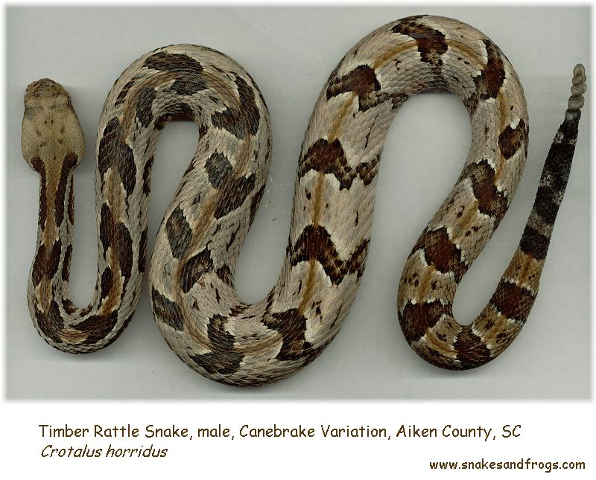

Slide 28
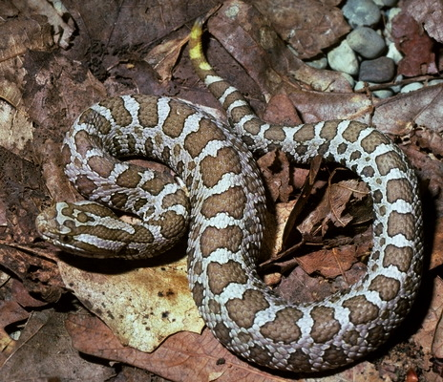
Eastern Massasauga Rattlesnake
Sistrurus catenatus
Notes:
Family - Crotalidae
Sistrurus catenatus
Massasauga Rattlesnake
- Light brown spots on a gray background
- Dark underside
- Keeled scales
- Anal plate single
- Tail terminating in a rattle
- Deep facial pits present about midway between eyes and nostrils
- Found only in a few counties in Ohio, associated with glaciation
- On endangered species list
- Found in wet prairies, bogs, and swamps
- Sometimes called the “swamp rattler”

Slide 29
Other Ohio Snakes
Not in our collection
Butler’s Garter Snake – Thamnophis butleri
Rough Green Snake – Opheodrys aestivus
Black Kingsnake – Lampropeltis getulus
Kirtland’s Snake – Clonophis kirtlandii
Smooth Earth Snake – Virginia valeriae
Copperbelly Water Snake – Nerodia erythrogaster
Lake Erie Water Snake - Nerodia s. insularum
Notes:
Butler’s garter snake can be distinguished from the others behaviorally; they will shuffle side-ways to evade predators

Slide 30
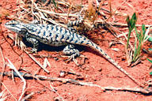
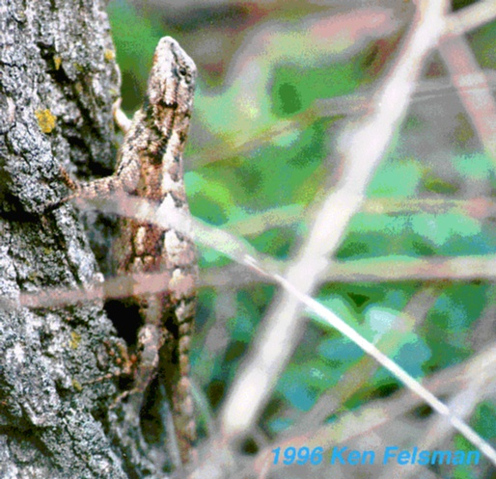
Northern Fence Lizard
Sceloporus undulatus
Notes:
Family – Iguanidae (Phrynosomatidae)
Sceloporous undulatus
Fence Lizard
- Body is gray/brown
- Scales are keeled
- Long feet w/ claws
- Belly is whitish w/ black specks
- Small lizard, 4-7”
- Only “spiny” lizard in Ohio

Slide 31
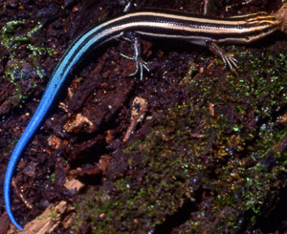
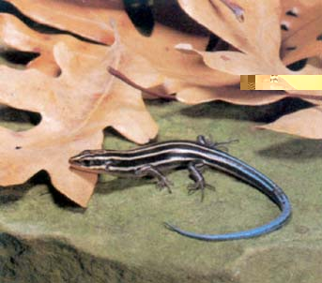
Five-lined Skink
Pletiodon fasciatus
Notes:
Family – Scincidae
Plestiodon fasciatus
Five-lined Skink
- 5 lines run down the length of the body
- Body is long & slender
- Tail is very long, and blue in juveniles
- Back legs have a very long toe
- Typically 5-8”
- Fairly common in Ohio, in moist, wooded areas w/ rotting wood
- Juveniles have a blue tail that serves 2 functions
- It is able to be autonomized to distract a predator
- It keeps younger immature males safe from attack by adult males (denotes young age)

Slide 32
Other Ohio Lizards
Not in our Collection
Ground Skink - Scincella lateralis
European Wall Lizard - Podarcis muralis
Notes:
Ground skink – Extreme southern Ohio, found in open areas near woods.
European Wall Lizard – Introduced in Cincinnati in 1951
- Two lizards were reportedly brought to the area from northern Italy by a local resident after a vacation near Milan and were released in a
backyard. The lizards now occupy an area slightly larger than two square miles, with population densities of 1,500 per acre in good
habitat. Because they have persisted for many years and survived through record-setting severe winters, they are considered permanent
residents.

Slide 33
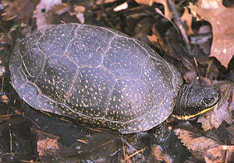
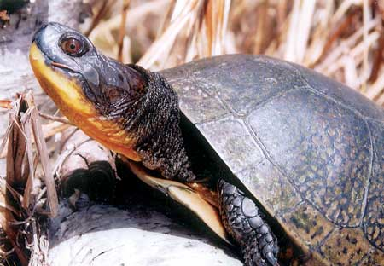
Blanding’s Turtle
Emydoidea blandingii
Notes:
Family – Emydidae
Emydoidea blandingii
Blanding’s turtle
- Carapace: dark with yellow speckles
- Plastron: yellow with a large black blotch on the edge of each scute
- Bright yellow on chin and throat
- typically 5-7”, record of 10-3/4”
- Plastron is hinged like box turtle, but does not close as well
- Aquatic
- Limited to Lake Erie costal marshes
- Protected in Ohio

Slide 34
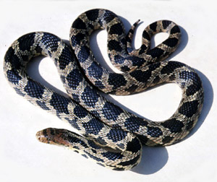

Eastern Fox Snake
Minotonius vulpinus
Notes:
Family – Colubridae
Mintonius vulpinus
Fox Snake
(Slide only)
- Gold w/ black saddle markings
- Head is a rusty red color and it’s often confused with the copperhead
- Scales are weakly keeled
- Anal plate divided
- Typically 4-5’
- Found in Lake Erie costal wetlands
- Trouble in Ohio because of development of habitat
Can rattle it’s tail, also confused w/ rattlesnake

Slide 35



Eastern Hognose Snake
Heterodon platyrhino
Notes:
Family – Xenodontidae
Heterodon platyrhino
Eastern Hognose Snake
(slide only)
- Typically has dark blotches on a lighter background, but all black specimens frequently found
- Upturned snout – used for digging, digs to find toads which it its almost exclusively
- Scales are strongly keeled
- Anal plate divided
- Small (2-3’) heavily bodied snake
- Has small rear fangs, not poisonous to humans but instead used to “pop” inflated toads.
- Found in areas with sandy soil, mostly in south-east and north-west Ohio
- Impressive defense mechanisms: flattens neck and makes hissing noises, shakes tail in leaf litter (sounds like rattler), if that fails he plays dead;

Slide 36


Broad-head Skink
Plestiodon laticeps
Notes:
Family – Scincidae
Plestiodon laticeps
Broad-headed Skink
(slide only)
- Scales are smooth
- Fairly common in S. Ohio
- Head is bright red
- No markings at all on the back
- Ohio’s largest skink, up to 12”

