Slide 1
Fish Dissections
Use caution
Delicately make incisions
Use scisors
Cut medial line on ventral side
Cut lateral section out to view internal anatomy through a “window” on the side

Slide 2
Short guide to fish dissection
Remove gill arches
Pharyngeal Teeth
Gill Rakers
Gill lamellae
Remove a section of scales
Examine under compound microscope (Aging organisms)
Examine musculature
hypaxial/epaxial muscles
Examine mouth structure
Track digestive system
Identification of parts
Compare and examine fish with respect to digestive tract complexity and length
Heart and circulatory structure
Misc. Identification of parts
i.e., Excretory and reproductive system, swim bladder

Slide 3
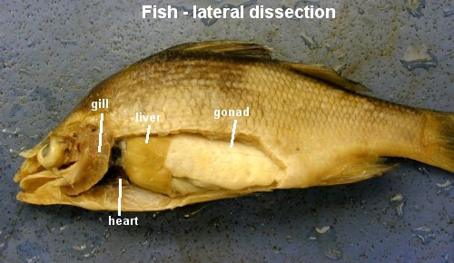

Slide 4
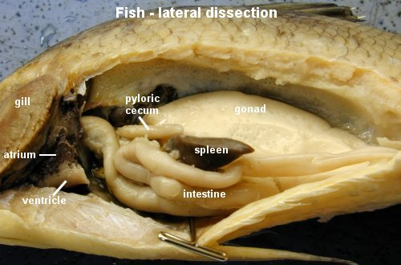

Slide 5
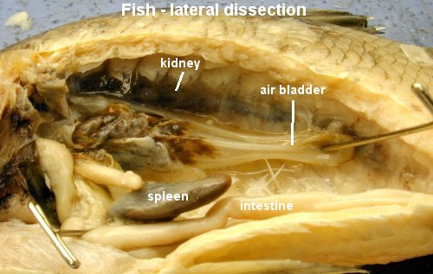

Slide 6
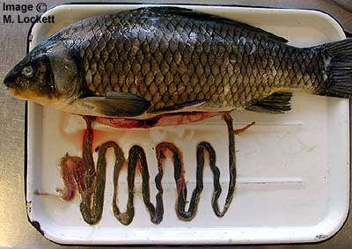

Slide 7
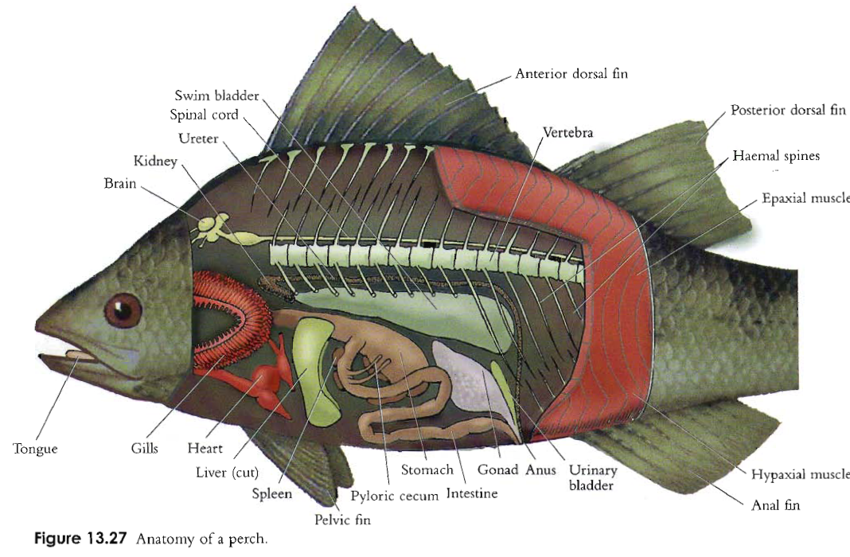

Slide 8
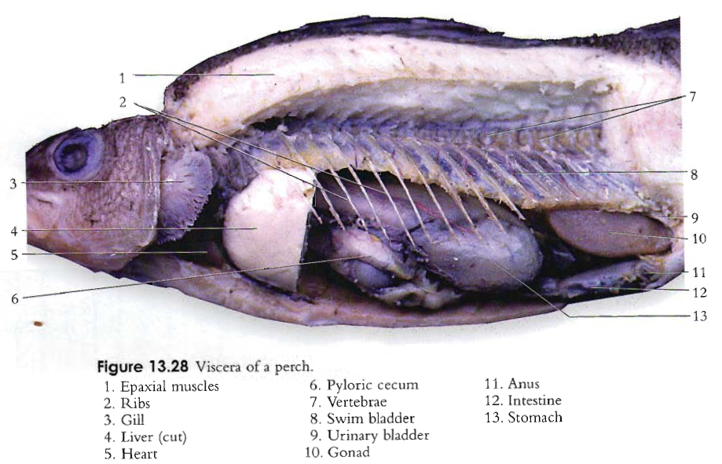

Slide 9
http://www.amonline.net.au/fishes/students/dissect/index.htm

